Slide 1

Natural Language Processing
Dr.R.Uma Maheswari
Data Scientist
nybl

Slide 2

Topics to discuss Agenda
Applications and Business Use Cases
02
Overview of NLP
What , Why ,History Timeline
How ??? Phases of NLP, subfields, Components
Language Modelling
LM vs LLM
01
03
04

Slide 3
What ?????????
Statistics
Computational Linguistics
Machine/Deep Learning
Natural language processing (NLP) is a form of Artificial Intelligence that gives computers the ability to interpret, manipulate, and comprehend human language.
NLP combines computational linguistics(rule-based modeling of human language) with statistical, machine learning, and deep learning models.
NLP

Slide 4
Why ?????????
NLP plays a pivotal role in bridging the gap between human communication and machine understanding.
NLP harness the power of human language to improve various aspects of technology, communication, and decision-making.
It’s impact spans across industries and domains including healthcare, finance, education, banking , energy , oil and gas etc
NLP automates tasks that traditionally required human intervention, such as data entry, content generation, and customer support.
NLP is vital to process tons of unstructured data , to extract insights and helps business leaders to make informed decisions.
NLP is a field of study that deals with interactions between computers and human languages

Slide 5
NLP History Timeline
1950-1960
1960-1970
1970-1980
1980-1990
Machine Translation
Syntactic Structures
Generative Grammer
Eliza –I chatbot
ALPAC-Automatic Language Processing
Augmented Transition Network
ATR-Automatic Translation System
EARL Electronic Associate Representation Language
Frame Semantics
HPSG-Head-Driven Phrase Structure Grammar
Statistical NLP
Word Sense Disambiguation
Parts of Speech Tagging
1990-2000
2000-2010
2010-2020
2020-2024
Hidden Markov Models
Statistical Machine Translation
WordNet
Ontologies and Semantic Web
Named Entity Recognition
Machine Learning Resurgence
Conversational Agents
Word Embeddings
Statistical Parsing
Semantic Analysis and Sentiment Analysis
Deep Learning
Transformers
Transfer Learning
Multimodal Learning
Ethical Considerations
Industry Adoption
Language Understanding Evaluation Benchmarks
Large Language Models
Conversational AI
Model Distillation and quantization techniques.

Slide 6
Applications of NLP -1
Improved User Experience: NLP enables more natural and intuitive interfaces, such as voice assistants and chatbots, which enhance user experience by allowing users to interact with technology using their natural language. This simplifies complex tasks and reduces the learning curve for using new applications.
Efficient Information Retrieval: NLP techniques power search engines to understand and interpret user queries, enabling more accurate and relevant search results. This improves the efficiency of information retrieval, saving time for users and helping them find the information they need more quickly.
Automated Analysis of Large Datasets: NLP enables automated analysis of large volumes of text data, such as customer feedback, social media posts, and news articles. By extracting valuable insights, trends, and patterns from this data, NLP empowers organizations to make data-driven decisions more efficiently.
Language Translation: NLP powers machine translation systems that facilitate communication and collaboration across language barriers. This has significant implications for global businesses, international diplomacy, and cross-cultural understanding.

Slide 7
Applications of NLP -2
Sentiment Analysis and Opinion Mining: NLP techniques enable sentiment analysis and opinion mining, allowing organizations to gauge public sentiment, customer satisfaction, and brand perception from text data sources such as social media, customer reviews, and surveys. This information can inform marketing strategies, product development, and customer service initiatives.
Content Generation and Personalization: NLP facilitates content generation and personalization by automatically generating text-based content, such as product descriptions, news articles, and personalized recommendations. This helps businesses deliver relevant and engaging content to their audience at scale.
Enhanced Decision-Making: By providing valuable insights from text data, NLP empowers decision-makers to make more informed and timely decisions. Whether it's identifying emerging trends, understanding customer feedback, or assessing market sentiment, NLP-driven insights can support strategic planning and decision-making across various domains.

Slide 8
NLP Business Use Cases
Brand Monitoring in Marketing
Intelligent Document processing
Clinical Text Mining in Healthcare
Fraud Detection and Security in Insurance Domain
Recruitment and HR Analytics
Legal Contract Analysis and Automation
Underwriting and risk assessment in Banking
Customer Engagement and Energy Conservation
Report Mining in Oil and gas
Reliability reporting
Chatbots and Virtual Assistants
Targeted Advertising
Speech and Speaker Recognition

Slide 9
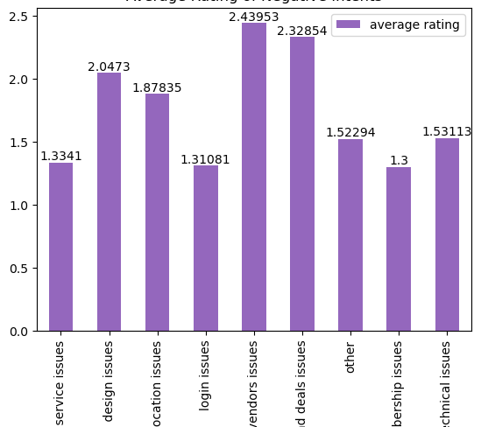
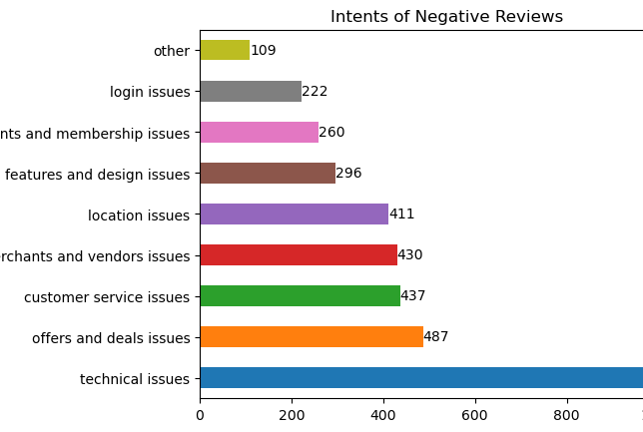
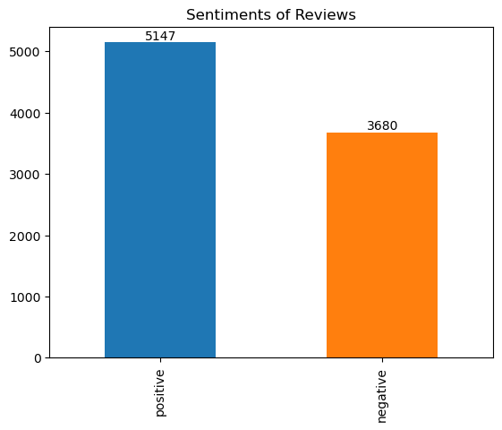
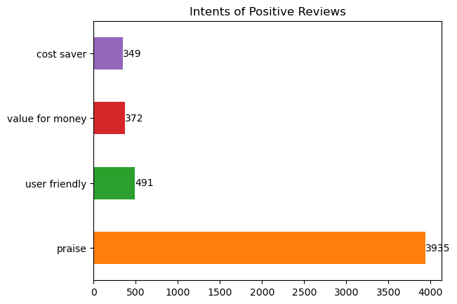
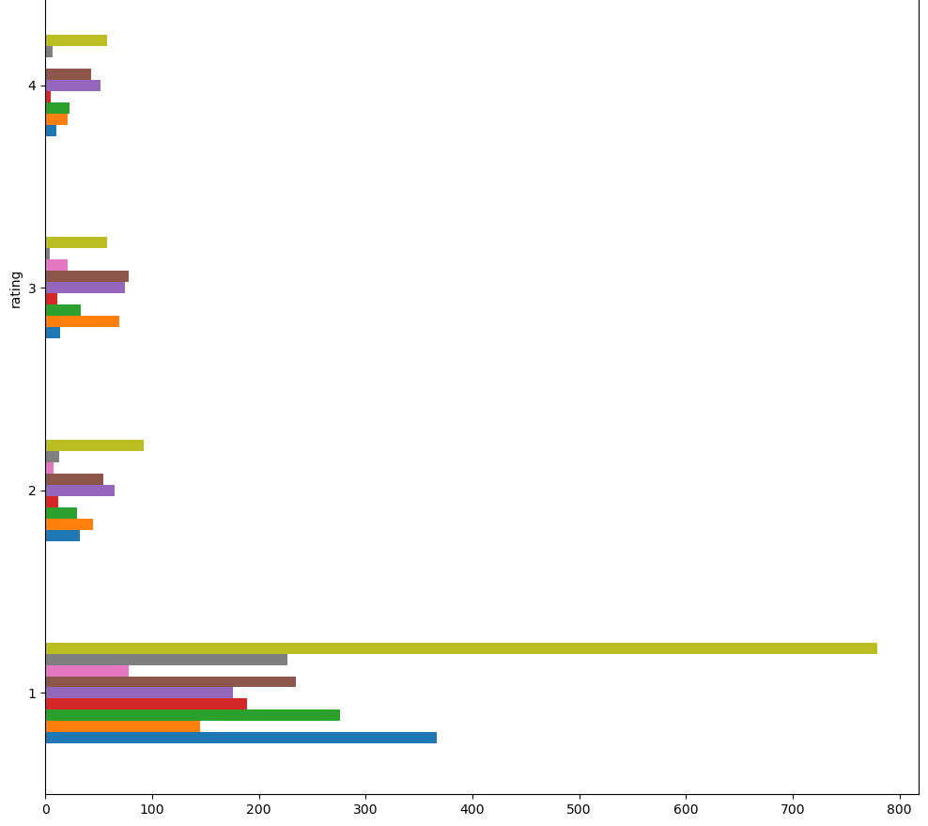
Brand Monitoring
Customer Feedback Analytics
Sentiment Analysis
Intent Detection

Slide 10
Five Phases of NLP
Lexical analysis segments texts into units like paragraphs, sentences, phrases, and words. In this phase , the text split into meaningful language units (morphemes) that you can’t further divide.
1
Lexical Analysis
analyzes a sentence's grammatical structure to determine its syntactic components and relationships. In this phase, sentences are tagged into parts of speech
2
Syntactic Analysis
Semantic analysis
Semantics describe the meaning of words, phrases, sentences, and paragraphs. Semantic analysis attempts to understand the literal meaning of individual language selections, not syntactic correctness.
3
4
Discourse Integration
Discourse integration analyzes prior words and sentences to understand the meaning of ambiguous language. Discourse integration takes into account the context of the text.
Pragmatic Analysis
describes the interpretation of language’s intended meaning. Pragmatic analysis attempts to derive the intended—not literal—meaning of language.
5
Notes:
Lexical:
There are 2 types of morphemes:
Free morphemes function independently as words (like “cow” and “house”).
Bound morphemes make up larger words. The word “unimaginable” contains the morphemes “un-” (a bound morpheme signifying a negative context), “imagine” (the free morpheme root of the whole word), and “-able” (a bound morpheme denoting the root morpheme’s ability to end).
Syntatic:
Uma wrote the paper -> Syntactically Correct
Uma do speaks -> Syntactically in correct
Semantic
Coimbatore Calls out to Uma -> Syntactically Correct
But not Semantically
Because Coimbatore is a place (and can’t literally call out to people), the sentence’s meaning doesn’t make sense.
Discourse:
R Rehman sings a song. That is amazing . Here the word that depends on the context of the previous sentence.
Pragmatic”
What a great customer service it sucks

Slide 11
Key Challenges
Ambiguity
Variability
Syntax and Grammar
Context Dependency
Lack of Data
Domain Specificity
Ethical and Bias Issues
Multimodality
Evaluation Metrics
Notes:
Ambiguity: Language is inherently ambiguous, with words and phrases often having multiple meanings depending on context. This ambiguity can pose challenges for tasks such as word sense disambiguation, semantic analysis, and understanding user intent.
Variability: Language use varies widely across different contexts, regions, and social groups. Variability in vocabulary, grammar, dialects, slang, and cultural nuances can make it challenging to develop NLP models that generalize well across diverse linguistic environments.
Syntax and Grammar: Parsing and understanding the syntactic and grammatical structure of sentences is a fundamental challenge in NLP. Sentences can have complex structures, and understanding their syntax requires dealing with phenomena such as recursion, coordination, ellipsis, and agreement.
Context Dependency: The meaning of words and sentences often depends on the surrounding context. Resolving context dependency is crucial for tasks such as coreference resolution, discourse analysis, and sentiment analysis, but it can be challenging, especially in complex or ambiguous contexts.
Lack of Data: NLP models typically require large amounts of annotated data for training, but obtaining high-quality labeled data can be costly and time-consuming, especially for tasks requiring domain-specific knowledge or fine-grained annotations.
Domain Specificity: Language use varies across different domains (e.g., healthcare, legal, finance), and NLP models trained on general-purpose data may not perform well in domain-specific applications. Adapting NLP models to specific domains often requires domain-specific knowledge and data.
Ethical and Bias Issues: NLP models can inadvertently perpetuate or amplify biases present in the training data, leading to unfair or discriminatory outcomes. Addressing ethical concerns and mitigating bias in NLP systems is an ongoing challenge for the field.
Multimodality: With the increasing availability of multimodal data (e.g., text, images, audio), integrating information from multiple modalities poses new challenges for NLP. Developing models that effectively combine information from different modalities while preserving their complementary nature is a complex task.
Evaluation Metrics: Choosing appropriate evaluation metrics for NLP tasks is challenging due to the subjective nature of language understanding and generation. Designing evaluation benchmarks that capture the nuances and complexities of human language remains an ongoing challenge.
Addressing these challenges requires interdisciplinary approaches that combine insights from linguistics, cognitive science, computer science, and other fields. Advancements in NLP algorithms, d

Slide 12
Ambiguity At Various NLP Stages
Lexical Knowledge
Syntactic Knowledge
Semantic Knowledge
Discourse Knowledge
Pragmatic Knowledge
Lexical Ambiguity
Syntactic Ambiguity
Semantic Ambiguity
Anaphoric Ambiguity
Pragmatic Ambiguity
Notes:
Lexical ambiguity occurs when a word or phrase has multiple meanings or interpretations based on its lexical (dictionary) definition.
The bank is closed
bank → river bank ? Or financial institute?
Syntactic Ambiguity presence of two or more possible meanings within a single sentence or sequence of words
The chicken is ready to eat
Whether chicken is cooked and ready to be eaten or the chickens are ready to be fed?
Semantic ambiguity occurs when a word or phrase has multiple interpretations or meanings based on the context in which it is used.
She saw the man with glasses
Anaphoric Ambiguity: Anaphoric ambiguity occurs when a pronoun or a word refers back to a previous noun or phrase in the text, but the reference is unclear or ambiguous
John told Mark that he should finish the project by Friday he ??? John or Mark????
Pragmatic ambiguity, also known as contextual ambiguity or conversational ambiguity, occurs when the intended meaning of a statement is unclear due to factors such as the speaker's tone, non-verbal cues, or the context of the conversation.
Do you know what time is it?
Semantic (literal meaning) asking for the current time
Other meanings(pragmatic meanings) Expressing anger to someone who missed the due time or something

Slide 13
NLP Subfields
NLG
Natural Language Generation
NLG Generates Text/Speech from all kinds of data
Types: Text-to-Text Generation-> Input->existing human written text, output->machine generated text
Tasks: text summarization, language translation,
Text simplification, Grammer and spell correction
Types: Data-to-Text Generation->Input -> Structured Data or Instructions(Non-Linguistic Data), Output-> Natural language Text or Speech
Tasks: Automated Journalism, Weather Report/ Financial Report generation
Example: Weather forecasting system Input: temperature, humidity, and wind speed data
Output: weather report in natural language
NLU
Natural Language Understanding
NLU focus on extract meaning, entities, intents, and context ,dialects, slangs from the text or speech
Tasks:language parsing, semantic analysis, entity recognition, sentiment analysis, and intent classification
Input: Natural Language Text or Speech
Output: Structured Data or Metadata
Example: Automatic Ticket Routing System
Input: customer support tickets, Customer Complaints
Output: Entities such as topic, sentiment, and urgency

Slide 14
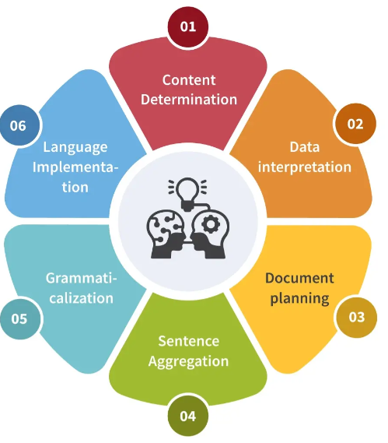
Components of NLG
Notes:
1.Content determination in NLG refers to the process of deciding what information needs to be conveyed in the generated text and in what order. This stage involves analyzing the input data or instructions and determining the key points or messages that should be included in the output text. Content determination is crucial for ensuring that the generated text is relevant, informative, and effectively communicates the intended message.
2. "Data Interpretation" stage in Natural Language Generation (NLG) refers to the process of analyzing and understanding the input data that will be used to generate natural language text . This stage involves transforming raw data into meaningful information that can be expressed in human-readable language.
3. Document planning is a crucial stage where the system decides how to organize and present the information to achieve the desired communicative goals effectively . This is Macro planning stage it involves Structural Organization, Textual Cohesion, Audience Adaptation, Document Goal overall The structure and content of the document should align with its intended purpose and audience.
4.Sentence Aggregation: Sentence aggregation in Natural Language Generation (NLG) refers to the process of combining multiple sentences or clauses into a single, more concise and coherent sentence. This technique is often used to improve readability, reduce redundancy, and enhance the overall fluency of generated text.
5. "grammaticalization" refers to the process of generating grammatically correct sentences or text based on underlying rules or structures of a language. It involves transforming semantic representations or abstract structures into well-formed linguistic expressions that adhere to the grammatical rules and conventions of the target language.
6. Language Implementation This stage involves inputting data into templates and ensuring that the document is output in the right format and according to the preferences of the user.

Slide 15
Types of NLG Systems
Template Based NLG
use predefined templates to generate text based on input data
substitute placeholders in templates with relevant data
Rule Based NLG
use linguistic rules and grammatical structures to generate text.
Need linguists and domain experts in loop
Statistical NLG
Trainable NLG
learn statistical patterns from large datasets to generate text
A weather report generator that fills in a template like "The weather in [location] is [temperature] with [condition]
A medical report generator that follows specific guidelines to create patient summaries based on diagnosis and treatment
rely on probabilistic models to generate natural language.
N Gram Models , Hidden Markov Models are widely used.
can be trained or fine-tuned on specific datasets or tasks to improve their performance
Machine learning/ Deep Learning techniques
Data driven approach
Hybrid NLG
systems integrate multiple NLG methods, such as template-based, rule-based, statistical, or deep learning approaches, to achieve more robust and versatile text generation capabilities.
Notes:
Statistical NLG :
statistical NLG system designed for generating product reviews The system analyzes the training data, learning the statistical patterns of how words and phrases are used in product reviews. For example, it learns that positive reviews often contain words like "excellent," "amazing," or "highly recommend," while negative reviews may include words like "disappointing," "poor quality," or "not worth it.“
In an n-gram statistical NLG system, the probability of the next word in a sequence is estimated based on the preceding n-1 words. These systems build probabilistic models from large text corpora, calculating the frequency of n-grams and their occurrences. By analyzing these frequencies, the system predicts the most likely next word given the context provided by the preceding words.
In an HMM-based NLG system, the hidden states represent underlying linguistic structures or concepts, while observable events correspond to the words in the generated text. The model learns the probabilities of transitioning between hidden states and emitting observable events from each state.

Slide 16
Language Modeling
Language Models are trained with Statistical / Machine Learning / Deep Learning techniques to predict the next word or sequence of next words.
Examples: N gram model, Hidden Markov Models , RNN , LSTM , GRU and Transformer Models
A pre-trained language model has been trained on a large corpus of data.
Pre training captures the underlying patterns, structures, and semantic knowledge present in the text corpus.
Pre training is an unsupervised technology , training is happening without the target labels.
In fine tunning , A pre trained model is tuned to excel in a certain task

Slide 17
Probabilistic Language models
Assigns probabilities to sequences of words in natural language.
For example, n-gram predicts the likelihood of a word (or sequence of words) occurring in a text given the previous n-1 words.
The "n" in n-gram represents the number of words considered as context.
A unigram model (n=1) predicts the probability of a word based solely on its own occurrence frequency in the text.
A bigram model (n=2) predicts the probability of a word based on the occurrence frequency of the previous word.
A trigram model (n=3) predicts the probability of a word based on the occurrence frequency of the previous two words, and so on.
"the quick brown fox jumps over the lazy dog
Bigrams: ("the", "quick"), ("quick", "brown"), ("brown", "fox") etc
Trigrams : ("the", "quick", "brown"), ("quick", "brown", "fox") etc
the probabilities of bigrams, where the probability of a word depends only on the preceding word.

Slide 18
Calculation of Next word Probability
"the quick brown fox jumps over the lazy dog
Step 1: Tokenization
Tokens: ["the", "quick", "brown", "fox", "jumps", "over", "the", "lazy", "dog"]
Step 2: Counting Bigrams
("the", "quick"): 1
("quick", "brown"): 1
("brown", "fox"): 1
("fox", "jumps"): 1
("jumps", "over"): 1
("over", "the"): 1
("the", "lazy"): 1
("lazy", "dog"): 1
Step 3: Counting Unigrams
"the": 2
"quick": 1
"brown": 1
"fox": 1
"jumps": 1
"over": 1
"lazy": 1
"dog": 1
Step 4: Calculating Probabilities
calculate the probability of each bigram by dividing its count by the count of its starting word (unigram)
P("quick" | "the") = Count("the", "quick") / Count("the") = 1/2 = 0.5
P("brown" | "quick") = Count("quick", "brown") / Count("quick") = 1/1 = 1.0

Slide 19
Language Models Vs LLM
Language Models
Large Language Models
Relies heavily on predefined rules and statistical methods.
Deep stacked neural network architectures learn patterns and relationships directly from vast amounts of text data
Typically require feature engineering and manual tuning
Require minimal manual intervention or feature engineering.
Limited by the quality and quantity of training data, Often tailored to specific tasks and domains
Benefit from massive scale and diverse data sources. Versatile across a wide range of tasks without task-specific fine-tuning
N gram , HMM , Conditional Random Fields, LDA , Wordnet
GPT (Generative Pre-trained Transformer), BERT (Bidirectional Encoder Representations from Transformers), T5 (Text-to-Text Transfer Transformer), RoBERTa (Robustly optimized BERT

Slide 20
NLP Tools
NLTK
Spacy
Core NLP
AllenNLP
TextBlob
OpenNLP
Flair
Gensim
Spark NLP
HuggingFace
Langchain
llamaindex

Slide 21
Key points
NLP empowers business leaders with actionable insights, real-time intelligence, and enhanced decision-making capabilities, enabling them to navigate complex business environments
NLP is a field of study that deals with interactions between computers and human languages
,
Extracts valuable insights from textual data and automating tasks related to language understanding and generation
,
By leveraging NLP technologies effectively, businesses can optimize their budget allocation, reduce operational costs, and improve overall financial performance
,
NLP enhances operational efficiency, customer satisfaction, and competitive advantage for businesses across various industries

Slide 22
Diving Deep
Upcoming Topics
Evaluation Methods and Metrics
06
Knowledge Representation
Distance Algorithms
Text Preprocessing with Python
05
07
08

Slide 23
Knowledge Representation
Semantic Knowledge
Ontology
Definitions
Episodic Knowledge
It contains remembered instances of ontological
concepts (such as people, places, organizations, events, etc.),
It resolves around instances or events
Examples: Discrete or Continuous Events
Linear or Branching Events
Immediate or delayed Events
Constraints
Defaults
Behaviours

Slide 24
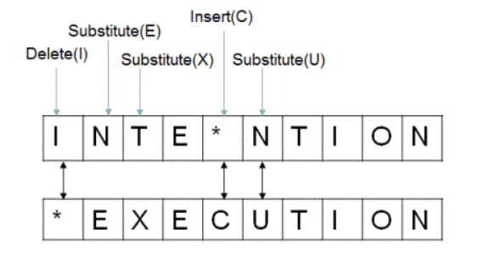
NLP Algorithms-1
The Minimum Edit Distance-Levenshtein distance: A measure to determine how dissimilar two strings (e.g., words) are to one another by counting the minimum number of operations required to transform one string into the other.
minimum number of insert/delete/substitute operations required to transform str1 into str2
E.g : str1=“ab” str2 =“abc”
To transform str1 to str2 the char C needs to be inserted in str1 therefore Edit Distance =1.
To transform str2 to str1 the Char C needs to be deleted in str2 therefore Edit Distance=1
E.g 2 str1 =“INTENTION” str2 =“EXCECUTION” Calculate Edit Distance
Five Operations Required to transform str1 to str2 .
Edit Distance =5

Slide 25
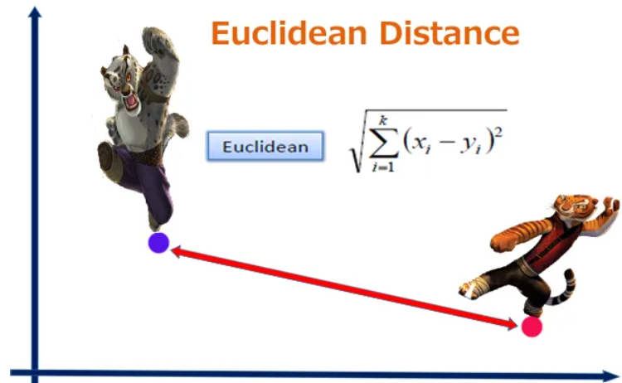
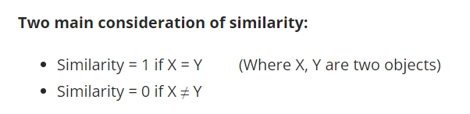
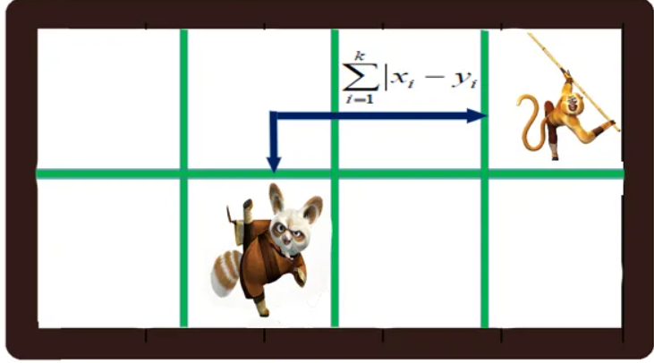
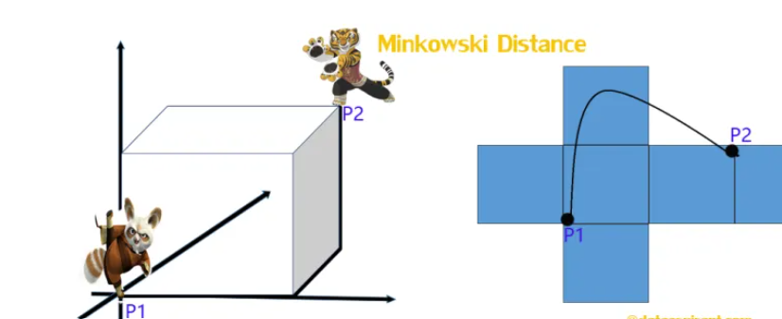
Similarity Measure is the distance with dimensions representing features of the data objects.
Small distance-> High degree of similarity
Large distance-> Low degree of similarity
Euclidean distance
Manhattan distance
Minkowski distance
Cosine Similarity
Jaccard Similarity
Length of the path connecting two points
similarity are measured in the range 0 to 1 [0,1]
Manhattan distance is the sum of the absolute differences of their Cartesian coordinates.
The Minkowski distance is a generalized metric form of Euclidean distance and Manhattan distance.

Slide 26
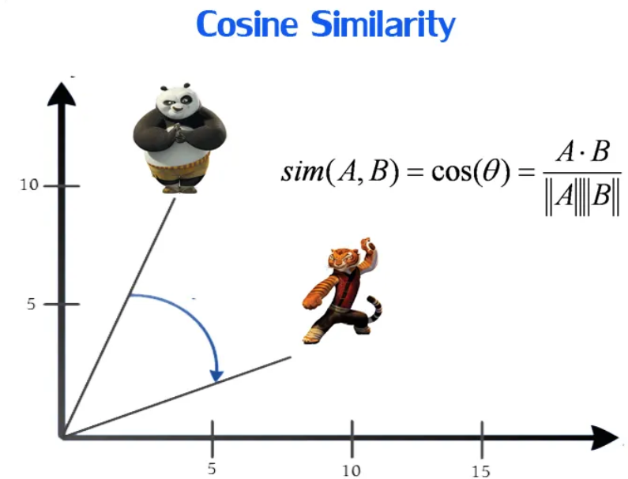
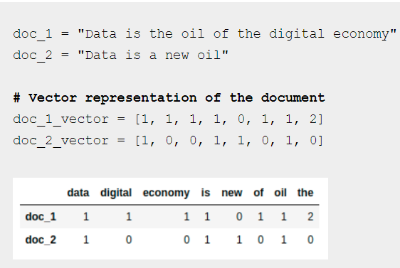
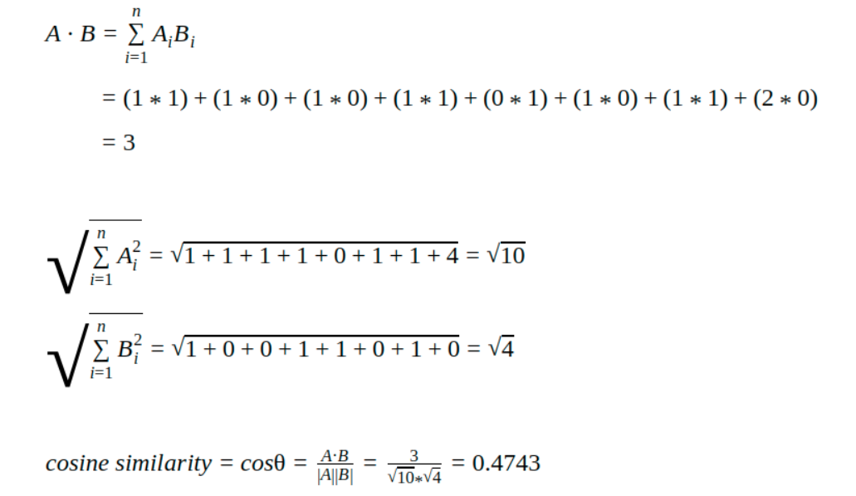
NLP Algorithms-2
Cosine Similarity : It is a metric used to measure how similar the documents are irrespective of their size.
it measures the cosine of the angle between two vectors projected in a multi-dimensional space.
The smaller the angle, higher the cosine similarity.

Slide 27
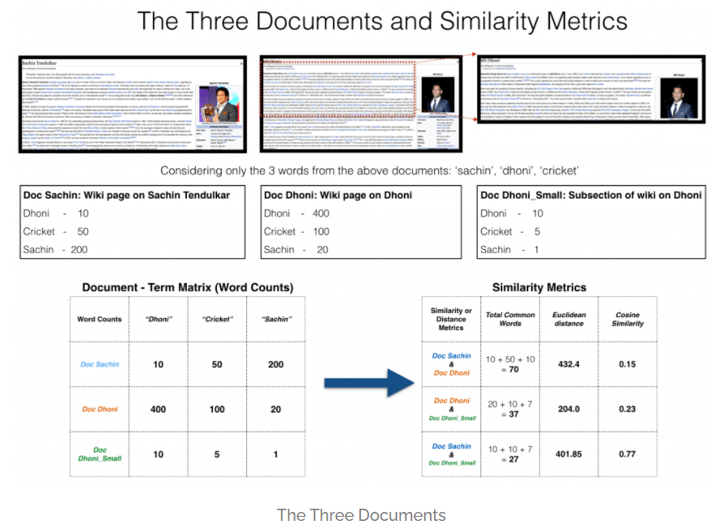
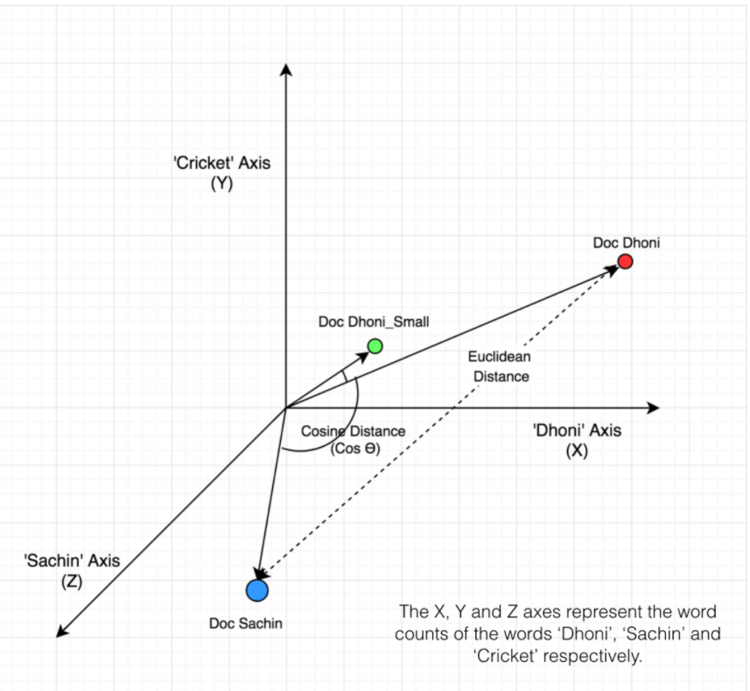
Cosine Similarity of docs
3 docs from the common cricket theme. Consider top three common words sachin,dhoni & cricket

Slide 28
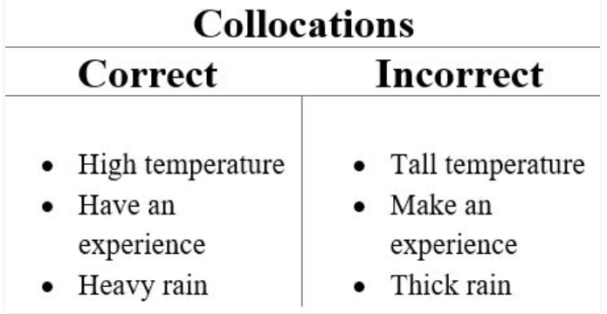
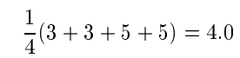
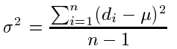
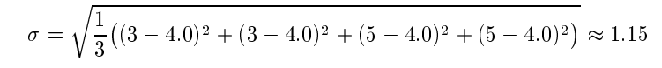
Collocations
Applications
Natural Language Generation
Computational Lexicography
Parsing
corpus linguistic research
Collocations – Two or more words that tend to appear frequently together.
The context in collocations will be a document in the form of a list of words.
Principal methods:
By Frequency: Counting the number of occurrences of the words occurs in the sequence.
Limitation: Fixed Phrase , Context is not considered eg MAN FORCE ( man and force can be both noun and adjectives)
By Mean and Variance: Offsets (signed distance between two words) mean and variance
she knocked on his door
They knocked at the door
100 women knocked on Donaldson’s door
a man knocked on the metal front door
Collocation: Knocked door , But the Phrase is variable . The different words comes in between the two words
Mean offset= Donaldson’s three tokens Donaldson , ‘ ,s
Offset Variance = d – Offset Distance , n – Number of times two words are co occur. µ mean.
Offset STD:

Slide 29
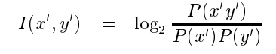
Collocations
Principal methods:
By Mean and Variance:
A low std -> Two words usually occurs at the same distance
Zero std -> Two words always occur at exactly the same distance.
Variance-based collocation discovery is the appropriate of words that are in a looser relationship than fixed phrases.
By Hypothesis Testing :
Used to assess that two words occur together more often than chance.
null hypothesis H0: there is no association between the words beyond chance occurrences.
compute the probability p that the event would occur if H0 were true,
and then reject H0 if p is too low (typically if beneath a significance level of p < 0:05, 0:01, 0:005, or 0:001)
and retain H0 as possible otherwise
By Mutual Information:
Mutual information is a measure of how much one word tells us about the other.
It measures the reduction of uncertainty about the occurrence of one word when we are told about the occurrence of the other.

Slide 30
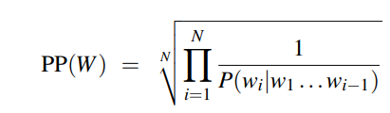
Evaluating Language Models
Evaluation
Extrinsic Evaluation
Intrinsic Evaluation
End –End Evaluation-Embed the model into application and measures the performance
It measures the quality of the model independent of the application
Test Corpus is required for evaluation
Whichever model predicts higher probability to the test set is the best model
Metric for Intrinsic Evaluation
The perplexity (sometimes called PP for short) of a language model on a test set is the inverse probability of the test set, normalized by the number of words. Perplexity is the weighted average branching factor of a language. The branching factor of a language is the number of possible next words that can follow any word

Slide 31
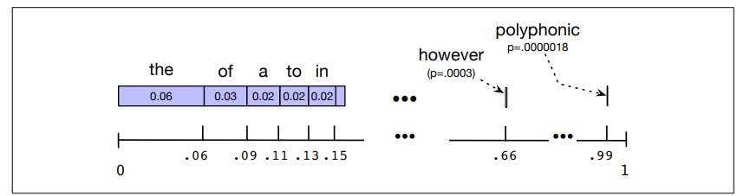
Estimating the Parameters :Sampling
Sampling from a distribution means to choose random points according to their likelihood.
A visualization of the sampling distribution for sampling sentences by repeatedly sampling unigrams.
The blue bar represents the frequency of each word.
The number line shows the cumulative probabilities.
If we choose a random number between 0 and 1, it will fall in an interval corresponding to some word.
The expectation for the random number to fall in the larger intervals of one of the frequent words (the, of, a) is much higher than in the smaller interval of one of the rare words (polyphonic).

Slide 32
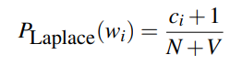
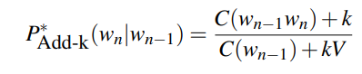
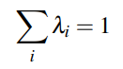
Estimating the Parameters :Smoothing
Most frequent events probability are removed from the language models to avoid zero probability prediction on unseen data is called smoothing or discounting.
Add one smoothing
V – Words in Vocabulary
Add k Smoothing instead of one fractional count k added
Laplace Smoothing- Add one to all the n gram counts before normalize into probabilities.
Absolute discounting: Subtracts a discount d from each count.
Backoff : to lower order n gram only if higher order n gram has zero evidence. Interpolation: Combine different order n grams by interpolation.
Kneser-Ney Smoothing Low order n grams probability estimator.
A frequent word occurring in only one context has lower continuation probability

Slide 33

Text Preprocessing
Text Normalization Techniques
Case Folding
Noise Removal
Punctuation Removal
Tokenization
Stemming and Lemmatization
POS Tagging
Text Vectorization Techniques
Bags of Words( Count) Vectorization
TF-IDF Vectorization
Word Embeddings

Slide 34
Text Pre Processing
Text Normalization: Improves quality of the text and making it suitable for machines to process
Case Normalization: Process of consolidating multiple spellings of a single word that differ only in capitalization.
Stop Word Removal: Stop words are the English words which does not add much meaning to a sentence.
Text Vectorization: Process of converting textual data into numerical representation of features
Count Vectorization- Bags-of-Words
TF-IDF Vectorization- Term Frequency – Inverse Document Frequency
Punctuation Removal: Remove special characters
Tokenization: Splitting text into paragraphs to sentences to words to characters
Stemming: process of reducing inflection in words (e.g. troubled, troubles) to their root form (e.g. trouble) ( remove some characters from words)
POS Tagging: POS tagging is a task of labelling each word in a sentence with its appropriate part of speech
Word Embeddings- Wod2Vec Neural Network Vectorizers
Lemmatization: transforms words to the actual root by use specific rules or dictionary lookup approach

Slide 35
Bags of Words
Text: “Bitty bought the butter but the butter was bitter so bitty throws the bitter butter out”
Algo: tokenize and sort in ascending order
Bags of words [“bitty”, ”bitter”,” bought”, ”but”, ”butter”, ”out”, ”so”, ”the”, ”throws”, “was”]
bitter | bitty | bought | but | butter | out | so | the | throws | was
2 | 2 | 1 | 1 | 3 | 1 | 1 | 3 | 1 | 1
Index | 0 | 1 | 2 | 3 | 4 | 5 | 6 | 7 | 8 | 9
Vector | 2 | 2 | 1 | 1 | 3 | 1 | 1 | 3 | 1 | 1
An encoding vector is thus returned with the length of the entire vocabulary(All unique Words or length of BOWS)
and integer count for the number of times each word occurs In the sentence.

Slide 36
Doc1 : I like natural language processing but I don’t love python Doc2: I love image processing and I like python doc3: I like image processing and signal processing
Corpus size =3
Bags of Words [ and, but, don’t, I, image, language, like, love, natural, processing, python, signal]
Len of BOWS= 11=vector size
Words/Count | and | but | dont | i | image | languaage | like | love | natural | processing | python | signal
Doc1 | 0 | 1 | 1 | 2 | 0 | 1 | 1 | 1 | 1 | 1 | 1 | 0
Doc2 | 1 | 0 | 0 | 2 | 1 | 0 | 1 | 1 | 0 | 1 | 1 | 0
Doc3 | 1 | 0 | 0 | 1 | 1 | 0 | 1 | 0 | 0 | 2 | 0 | 1

Slide 37
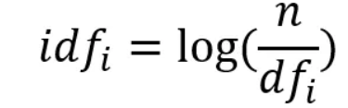
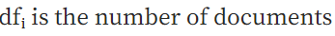
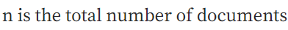
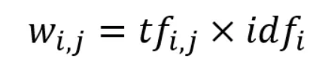
TF IDF
TF Term Frequency is the number of occurrences of a specific term in a document. Term frequency indicates how important a specific term in a document.
DF Document frequency is the number of documents containing a specific term. Document frequency indicates how common the term is.
Inverse document frequency (IDF) looks at how common (or uncommon) a word is amongst the corpus.
TF-IDF Score

Slide 38
Calculating TF-IDF
Doc 1: I love natural language processing by using python.
Doc 2 I like image processing but I hate python
Doc 3: I like signal processing and image processing in cat images
Step 1: Create Term Frequency Matrix
Terms/Doc | and | but | by | hate | I | image | language | like | love | natural | processing | python | signal
Doc1 | 0 | 0 | 1 | 0 | 1 | 0 | 1 | 0 | 1 | 1 | 1 | 1 | 0
Doc 2 | 0 | 1 | 0 | 1 | 1 | 1 | 0 | 1 | 0 | 0 | 1 | 1 | 0
Doc 3 | 1 | 0 | 0 | 0 | 1 | 1 | 0 | 1 | 0 | 0 | 2 | 0 | 1
Step 2: Compute Inverse Document Frequency
Term | and | but | by | hate | I | image | language | like | love | natural | processing | python | signal
IDF | 0.477 | 0.477 | 0.477 | 0.477 | 0 | 0.176 | 0.477 | 0.176 | 0.477 | 0.477 | 0 | 0.176 | 0.477

Slide 39
Calculating TF IDF
Step 3 Compute TF-IDF Score Table 1 X Table 2
Terms/Doc | and | but | by | hate | I | image | language | like | love | natural | processing | python | signal
Doc1 | 0 | 0 | 1 | 0 | 1 | 0 | 1 | 0 | 1 | 1 | 1 | 1 | 0
Doc 2 | 0 | 1 | 0 | 1 | 1 | 1 | 0 | 1 | 0 | 0 | 1 | 1 | 0
Doc 3 | 1 | 0 | 0 | 0 | 1 | 1 | 0 | 1 | 0 | 0 | 2 | 0 | 1
X
Term | and | but | by | hate | I | image | language | like | love | natural | processing | python | signal
IDF | 0.477 | 0.477 | 0.477 | 0.477 | 0 | 0.176 | 0.477 | 0.176 | 0.477 | 0.477 | 0 | 0.176 | 0.477
Terms/Doc | and | but | by | hate | I | image | language | like | love | natural | processing | python | signal
Doc1 | 0 | 0 | 0.477 | 0 | 0 | 0 | 0.477 | 0 | 0.477 | 0.477 | 0 | 0.176 | 0
Doc 2 | 0 | 0.477 | 0 | 0.477 | 0 | 0.176 | 0 | 0.176 | 0 | 0 | 0 | 0.176 | 0
Doc 3 | 0.477 | 0 | 0 | 0 | 0 | 0.176 | 0 | 0.176 | 0 | 0 | 0 | 0 | 0.477

Slide 40
Summary –Bags of Words , TF-IDF
BOWS and TF-IDF are sparse vector representation. (A sparse vector is a vector having a relatively small number of nonzero elements)
It ignores the order of the word
It ignores the context of words
Computationally cheaper
Simple and easy to use

Slide 41
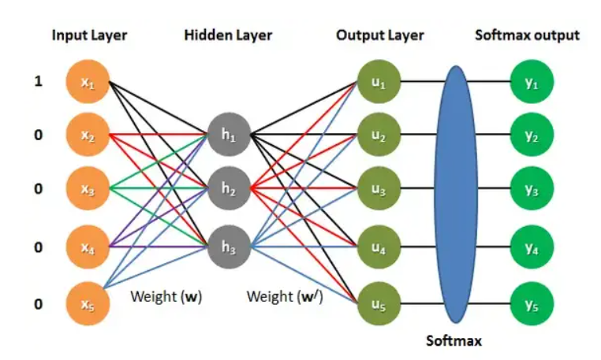
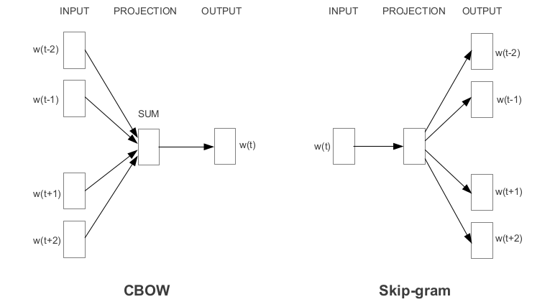
Word Embeddings –Word2Vec Representations
Dense Vector Representations. The words that are similar will have similar vector. Word Embeddings are represented by a neural network model that clusters similar information and establish a relationship between them
set of word-vectors where vectors close together in vector space have similar meanings based on context, and word-vectors distant to each other have differing meanings
CBOW Model
NN predict the target word from the context words
Skip gram
NN predicts the context word from the given target word

Slide 42
Regex- Regular Expressions
Meta Char | Usage
[ ] | Character class. Specifies set of characters to match e.g [a-z] matches all alphabets in lower case Metacharacters (except \) are not active inside classes. [^5] and matches any digit except 5 . [5^] matches to 5 or ^. If the caret appears elsewhere in a character class(not in start inside character class), it does not have special meaning.
\ | Signals a special sequence (can also be used to escape special characters) \\ matches \ in a string \[ matches [ in a string.
\w | Matches any alphanumeric character; this is equivalent to the class [a-zA-Z0-9_]
\W | Matches any non-alphanumeric character; this is equivalent to the class [^a-zA-Z0-9_] (matches special characters)
\d | Matches any decimal digit; this is equivalent to the class [0-9].
\D | Matches any non-digit character; this is equivalent to the class [^0-9]
\s | Matches any whitespace character; this is equivalent to the class [ \t\n\r\f\v]
\S | Matches any non-whitespace character; this is equivalent to the class [^ \t\n\r\f\v].
\b | Matches word boundaries when outside brackets. Matches backspace (0x08) when inside brackets.
. | Any character (except newline character)
^ | Matches beginning of line.
$ | Matches end of line

Slide 43
Regex- Regular Expressions
Meta Char | Usage
* | zero or more repetitions of preceding element
+ | one or more repetitions of preceding element
? | zero or one repetition of preceding element
{n} | exactly n repetitions of preceding element
{n,m} | from n to m repetitions of preceding element
{n,} | n or more repetitions of preceding element
() | Groups regular expressions and remembers matched text.
\A | Matches beginning of string.
\Z | Matches end of string. If a newline exists, it matches just before newline.
\z | Matches end of string.
| | Or

Slide 44
Regex Flags
Flag | Long syntax | Meaning
re.A | re.ASCII | Perform ASCII-only matching instead of full Unicode matching
re.I | re.IGNORECASE | Perform case-insensitive matching
re.M | re.MULTILINE | This flag is used with metacharacter ^ (caret) and $ (dollar). When this flag is specified, the metacharacter ^ matches the pattern at beginning of the string and each newline’s beginning (\n). And the metacharacter $ matches pattern at the end of the string and the end of each new line (\n)
re.S | re.DOTALL | Make the DOT (.) special character match any character at all, including a newline. Without this flag, DOT(.) will match anything except a newline
re.X | re.VERBOSE | Allow comment in the regex. This flag is useful to make regex more readable by allowing comments in the regex.
re.L | re.LOCALE | Perform case-insensitive matching dependent on the current locale. Use only with bytes patterns

Slide 45
Regex Methods
Method | Usage | syntax
match | looks for the regex pattern only at the beginning of the target string and returns match object if match found; otherwise, it will return None. | re.match(pattern, str, flags=0)
search | Matches pattern anywhere in the string. Return only first match | re.search(pattern, str, flags=0)
findall | scans the target string from left to right as per the regular expression pattern and returns all matches in the order they were found. | re.findall(pattern, string, flags=0)
finditer | works exactly the same as the re.findall() method except it returns an iterator yielding match objects matching the regex pattern in a string instead of a list, It scans the string from left to right, and matches are returned in the iterator form | re.finditer(pattern, string, flags=0)
split | split the string by the occurrences of the regex pattern, returning a list containing the resulting substrings | re.split(pattern, string, maxsplit=0, flags=0)
Replace(sub) | replace one or more occurrences of a regex pattern in the target string with a substitute string. | re.sub(pattern, replacement, string, [count, flags])
subn | Same as re.sub but returns a tuple of two elements The first element of the result is the new version of the target string after all the replacements have been made. The second element is the number of replacements it has made | re.subn(pattern, replacement, string, [count, flags])

Slide 46
Named Entity Recognition
Named entity recognition (NER) is the task of tagging entities in text with their corresponding type.
Dictionary based NER
Maintains and updates a dictionary
Rule based NER
Morphological rules are used to extract the entities.
Machine Learning/Deep Learning Based NER
ML/DL model trained to classify the entity tokens.
Training data should be annotated with entities.
string matching algorithms are used to detect entities
BIO SCHEME
I – Token is inside an entity.
Uma Maheswari Tamilvendhan is from south india state Tamilnadu
BILOU SCHEME
B – Token is the beginning of a multi-token entity.
Uma Maheswari Tamilvendhan is from south India state Tamilnadu
Uma- B- Person Maheswari – I-Person Tamilvendhan-I-Person
Is-O from-O
South –B GPE India- I GPE Tamilnadu- B GPE
Uma- B- Person Maheswari – I-Person Tamilvendhan-L-Person Is-O from-O State-0
South –B GPE India- I GPE Tamilnadu- U GPE
O – Token is outside an entity.
B – Token is the beginning of an entity.
I – Token is inside a multi-token entity.
L – Token is the last token of a multi-token entity.
U – Token is a single-token unit entity.
O – Token is outside an entity.

